Slide 1
The Marrakesh Treaty in a Nutshell
The Marrakesh Treaty in Action
Helsinki 12 March 2019
Kirsi Ylänne, IFLA LPD & Celia, Finland
Twitter: @kirsiylanne

Slide 2
IFLA LPD
IFLA - International Federation of Library Associations and Institutions
LPD – Libraries Serving Persons with Print Disabilities
The mission of LPD is to advocate for library services that are equitable and accessible for persons with a print disability.

Slide 3
IFLA LPD
Webpage: www.ifla.org/lpd
Facebook FB Page: facebook.com/iflalpd/ For discussion: IFLA LPD Group
Twitter: @IFLA_LPD

Slide 4
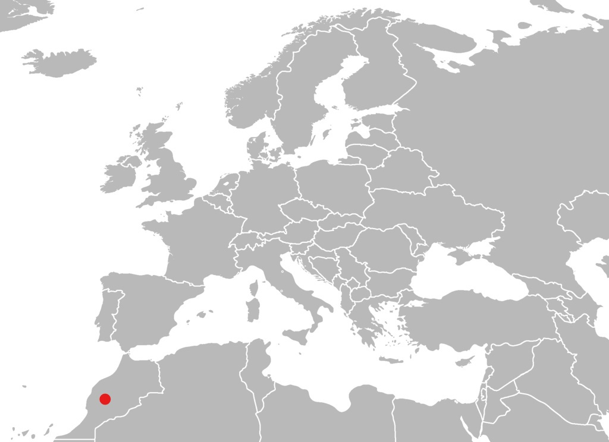
Marrakesh?
Image: CC BY-SA 3.0, https://commons.wikimedia.org/wiki/File:BlankMap-Europe-v4.png

Slide 5
The Marrakesh Treaty
An international treaty that was adopted in Marrakesch in June 2013
By member states of WIPO
WIPO = World Intellectual Property Organisation
A self-funding agency of the United Nations
The full title Marrakesh Treaty to Facilitate Access to Published Works for Persons Who Are Blind, Visually Impaired or Otherwise Print Disabled

Slide 6
What is the Treaty about?
An international legal framework
Countries who ratify the Marrakesh Treaty shall provide in their national copyright laws
A right to produce and distribute accessible copies of works for persons with print disabilities, and
A right to share accessible books across national borders (with other countries that have ratified the Marrakesh Treaty)
Permitted without the authorization of the copyright holder

Slide 7
Some options
Countries can decide themselves
If there will be a commercial availability check
Accessible copies can be produced if there is not a commercial accessible format available.
If there will be a system of remuneration
Authorized entities may be required to pay a royalty to copyright holders for producing or distributing accessible copies.

Slide 8
Situation today
The Treaty came into force on September 30, 2016
India was the first country to ratify and Canada was the 20th
There are 53 parties contracting the Marrakesh Treaty
Situation on 10 March 2019
The European Union is one of the parties
Directive 2017/1564 & Regulation 2017/1563
Into force in 28 EU member states January 1, 2019
All together 80 countries have ratified the Treaty

Slide 9
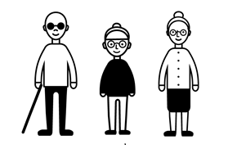
Key definitions 1/2
Persons with Print Disabilities
Persons who are blind or have a visual impairment
Persons who have a perceptual or reading disability
learning disability, dyslexia
Persons with physical disability who are unable to hold or manipulate a book

Slide 10
Key definitions 2/2
An accessible format copy of a literary work
“gives a beneficiary person access to the work, including to permit the person to have access as feasibly and comfortably as a person without visual impairment or other print disability.”
The focus is on the needs of a person with print disability, not on a format.
Braille book, tactile book, e-book, talking book, large print, easy-to-read book, etc.

Slide 11
An authorized entity
“is authorized or recognized by the government to provide education, instructional training, adaptive reading or information access to beneficiary persons on a non-profit basis.”
No explicit authorization is needed.
Any library that provides services on a non-profit basis is entitled to act as an authorized entity.
A right, not an obligation.

Slide 12
Libraries as authorized entities
are permitted to make accessible copies of a work
are permitted to distribute accessible copies to persons with print disabilities or other authorized entities
Also cross borders

Slide 13
Acting as authorized entity
An authorized entity establishes and follows its own practices
(i) to establish that the persons it serves are persons with print disabilities
(ii) to limit distribution of accessible copies only to persons with print disabilities and/or authorized entities
(iii) to discourage the reproduction, distribution and making available of unauthorized copies
(iv) to maintain due care in, and records of, its handling of copies of works, while respecting the privacy of persons with print disabilities.

Slide 14
Libraries should work together
Special libraries, academic libraries and public libraries should share information on their own practices.
Libraries should use the rights offered in the Marrakesh Treaty in order to help improve library and information services to persons with print disabilities.

Slide 15
A guarantee
Making all library services as accessible and inclusive as possible should be the goal.
If that goal isn’t achieved, the Marrakesh Treaty gives libraries a guarantee that they can help persons with print disabilities to access information and literature.

Slide 16
Thank you! Kiitos!
Email: kirsi.ylanne@celia.fi
Twitter: @kirsiylanne

