Slide 1
Oodi – the crown jewel of Finnish libraries
Lotta Muurinen
Project Manager
Helsinki City Library
National Development Services
International Tasks

Slide 2
Built on Töölö bay area in the center of Helsinki. Oodi means an ode: it is an ode for libraries in Finland, for reading, for democracy and for freedom of speech.

Slide 3
Building of Oodi central library started in fall 2015 and it was opened in 5th of December 2018 to celebrate the centennial of Finnish independence.

Slide 4
Few Oodi facts
Construction cost 100 million euros.
Collection 100 000 items (75% already loaned out).
10 000 square metres of space. The customer space is maximised – only 2 % is for the staff. The library governing stays in the main library.
Designed by ALA architects.
Has 9 living trees on the 3rd floor!

Slide 5
More than 20 000 visitors on the opening day.
More than 1000 new library cards made during the first opening week.
Over 800 000 visitors so far – average
10 000 per day, over 20 000 on some days.

Slide 6
Oodi – the process

Slide 7
Key ideas from the plan, 2012
• Open, non-commercial, public space.
• Information and skills for a more functional society.
• Rich city experience created by the residents themselves.
• The book’s new life –a house of reading in Töölönlahti.

Slide 8
Preparing
Different services piloted, especially in Library 10.
Training staff. The staff and the leaders were recruited from Helsinki City Library workers – no new vacancies were opened. The staff started working full time with Oodi from the beginning of October.
Benchmarking: Aarhus, Oslo, Helsinki University Library etc.

Slide 9
Accessibility
Accessibility was a key point all through the planning process: Oodi is a library for everyone.
All the floors are accessible by elevators.
Guide dogs are welcome to all the floors.
Audio guidance on the main doors and in BlindSquare.
Tactile signs and maps.
Induction loops on all the customer service points.
Guiding lines on the floors.

Slide 10
Behind the scenes

Slide 11
The Oodi crew – all 54 of them!

Slide 12
Service managers:
Kari Lämsä
Laura Norris
The library chief:
Anna-Maria Soininvaara
Customer Experience
Team leader Auli Aho
Digital Guidance
Team leader Sanna Huttunen
Service administrators:
Tia Jokinen
Sami Jyläs
Contents and Collections
Team leader Samu Eeve
Children and Youth
Team leader Tiina Pyre
Spaces and Participation
Team leader Ulla Leinikka

Slide 13
Self-governing teams: thumbs up or down!
The teams make decisions in regular meetings. They vote about the matters with showing thumbs up, down or with an open palm. An open palm means the person is worried. The worry is always talked through together.
Big issues are brought to vote with the whole staff.
The library leaders don’t lead teams but offer support and encourage in decision making.
Ehkä suurin muutos tässä on perinteisempiin organisointimalleihin verrattuna se, että tiimeillä ja henkilökunnalla on todellinen oikeus päättää. Ei vain mahdollisuus esittää asioita johdolle päätettäväksi.

Slide 14
Oodi – a safer space for all
Physical and emotional safety.
Diverse staff is more creative and innovative – but you have to be able to be and feel safe about who you are.
Workshops about safer space for the customers: staff’s attitude and active involvement is most important.
All the staff members have been involved in making the principles of safer space in Oodi. The process is always ongoing.
For example unisex toilets for all, gender neutral dressing rooms for the staff, including private shower space.

Slide 15
The first floor

Slide 16
The ground floor is an accessible and lively space where the entrance and service points meet. It includes the lobby, an exhibition area, playground for early education, an event spot, a café and restaurant and cinema.

Slide 17
Both the library’s and the partners’ info services are in the lobby. Any partner can also use the lobby for their pop up –info.

Slide 18
Next to the restaurant is an event space Maijansali with 200 seats for many kinds of events.

Slide 19
The lobby is an excellent space for premieres, gala evenings, receptions etc.

Slide 20
During the day time cinema fuctions as an auditorium for seminars, performances etc. (Note for the calendars: Reshape 2019 on 6-7 May!)

Slide 21
The indoor playground
The playground Loru (Rhyme) reaches both in- and outdoors and is created as a partnership with department of early education. There is place to eat packed lunch, hang around and leave the prams and wet outdoor clothes. The early education staff will keep the kids and families happily busy.

Slide 22
The second floor

Slide 23
The second floor is for hands-on activities. It is a place for working, creating, interacting and learning-by-doing.

Slide 24
Here you will find studios, gaming rooms, a makerspace, a kitchen, and areas for workshops, meetings, and other interactive exchanges.

Slide 25
These areas will be functional, with the option to make divided or enclosed areas as needed. They will be ideal for working, organizing meetings, testing ideas, editing videos or creating objects with 3D printers.

Slide 26
The cube
The cube can be used as an immersive space. The interactive glass walls function also as a touch screen. The space can be modified into a digital art gallery, a jungle full of animals or a meditative beach.

Slide 27
The kitchen
Kitchen can be used by customers for cooking up a favourite recipe from a book, trying out different food cultures and creating tasty workshops.

Slide 28
The third floor

Slide 29
The collection of 100 000 items lives on the third floor (and the
9 living trees too).

Slide 30
Under the cloud-like ceiling of the 3rd floor one can study, escape from hectic routines, or just admire the view of the city. This area provides the ideal atmosphere for reading and discovering.

Slide 31
The family and children’s area with multifunctional rooms for storytelling and other activities is situated in the north end of the building.

Slide 32
The balcony is on the same level with the parliament, symbolizing democracy.

Slide 33
The balcony is also a terrace for the café.*

Slide 34
* In the summer time.

Slide 35
Enjoy the Oodi Experience!

Slide 36
”One morning you might wake up to find you have been transformed into Gregor Samsa…”

Slide 37
Case: Oodi’s Metamorphosis
VR-adaptation of Kafka’s Metamorphosis where you actually change into an giant insect via VR technology.
First developed as VRwandlung to Goethe Institute in Prague.
Will change Oodi into a full Metamorphosis experience for a week in the autumn.
Kafka would have probably loved it!

Slide 38
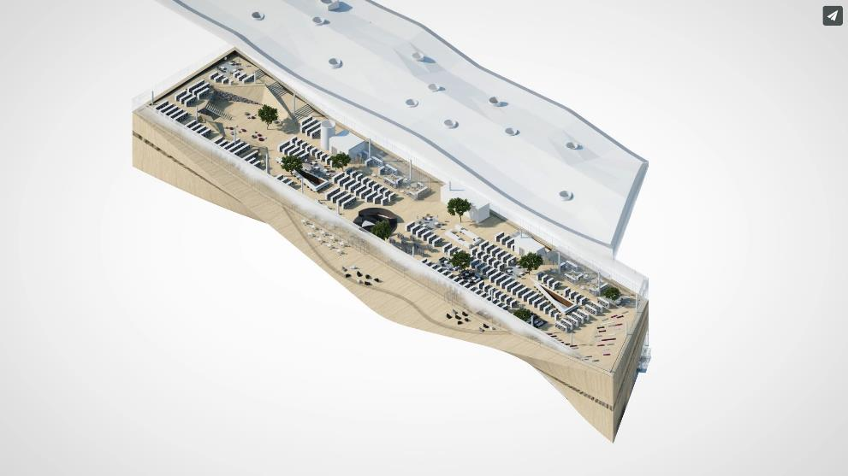
The 3rd floor
A big exhibition about Kafka’s work.
Reading aloud Metamorphosis in the cozy reading spaces.

Slide 39
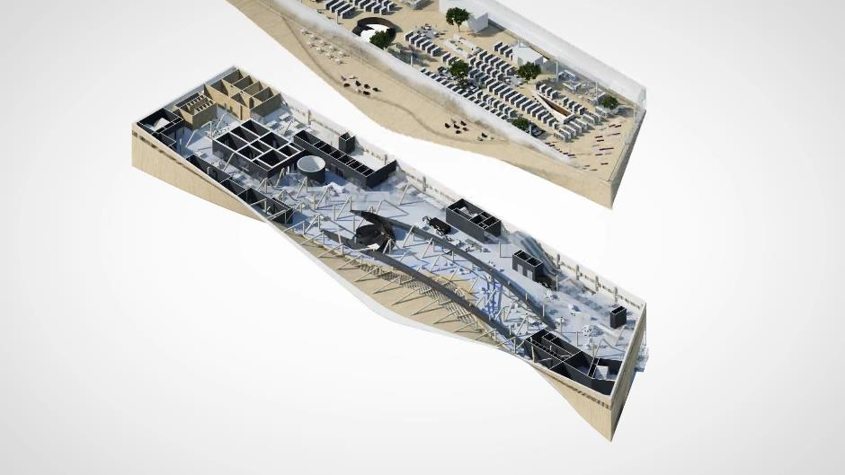
The 2nd floor
The actual VR adaptation in The Cube, with VR technology and interactive glass walls.
Studying and 3D-printing insect workshops for kids in the makerspace.
Cooking insect food in the kitchen.

Slide 40
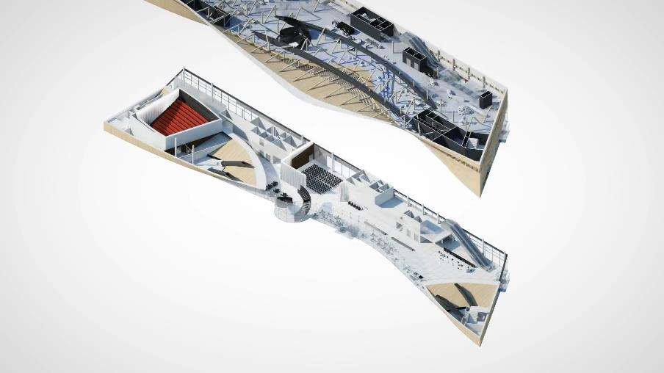
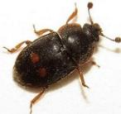
The 1st floor
A discussion about the metamorphosis of the society in the event space.
Film adaptations of Kafka’s work in the cinema.

Slide 41
”It’s a perfect coincidence of technology and text. You’re transformed by the headset, then you are transformed again in the story.”
”I am glad I am not an insect. Those annoying antennae, that complete helplesness.”
https://www.economist.com/books-and-arts/2018/03/08/is-literature-next-in-line-for-virtual-reality-treatment

Slide 42
Thanks for your company! Any questions? lotta.muurinen@hel.fi

